Slide 1
Fundementals of Image Processing
Detection of Texts From Photos and Their Translations
Utku Enes Baki - 201805051

Slide 2
Considering my topic from a global perspective...
In today’s rapidly advancing digital age, the ability to extract text from photos and translating it has become an important tool in many industry. This technology helps us how we interact with visual content and gives us power to easily extract textual information from images and connects us with global information via translations.

Slide 3


Here are some industries that uses text translation from images…
E-commerce:
Automatic translation of product descriptions from images and specifications for international markets.
Education and Research:
Translating text from research papers, articles, and books written in foreign language, historical documents or scripts to preserving and analyzing cultural heritage.

Slide 4

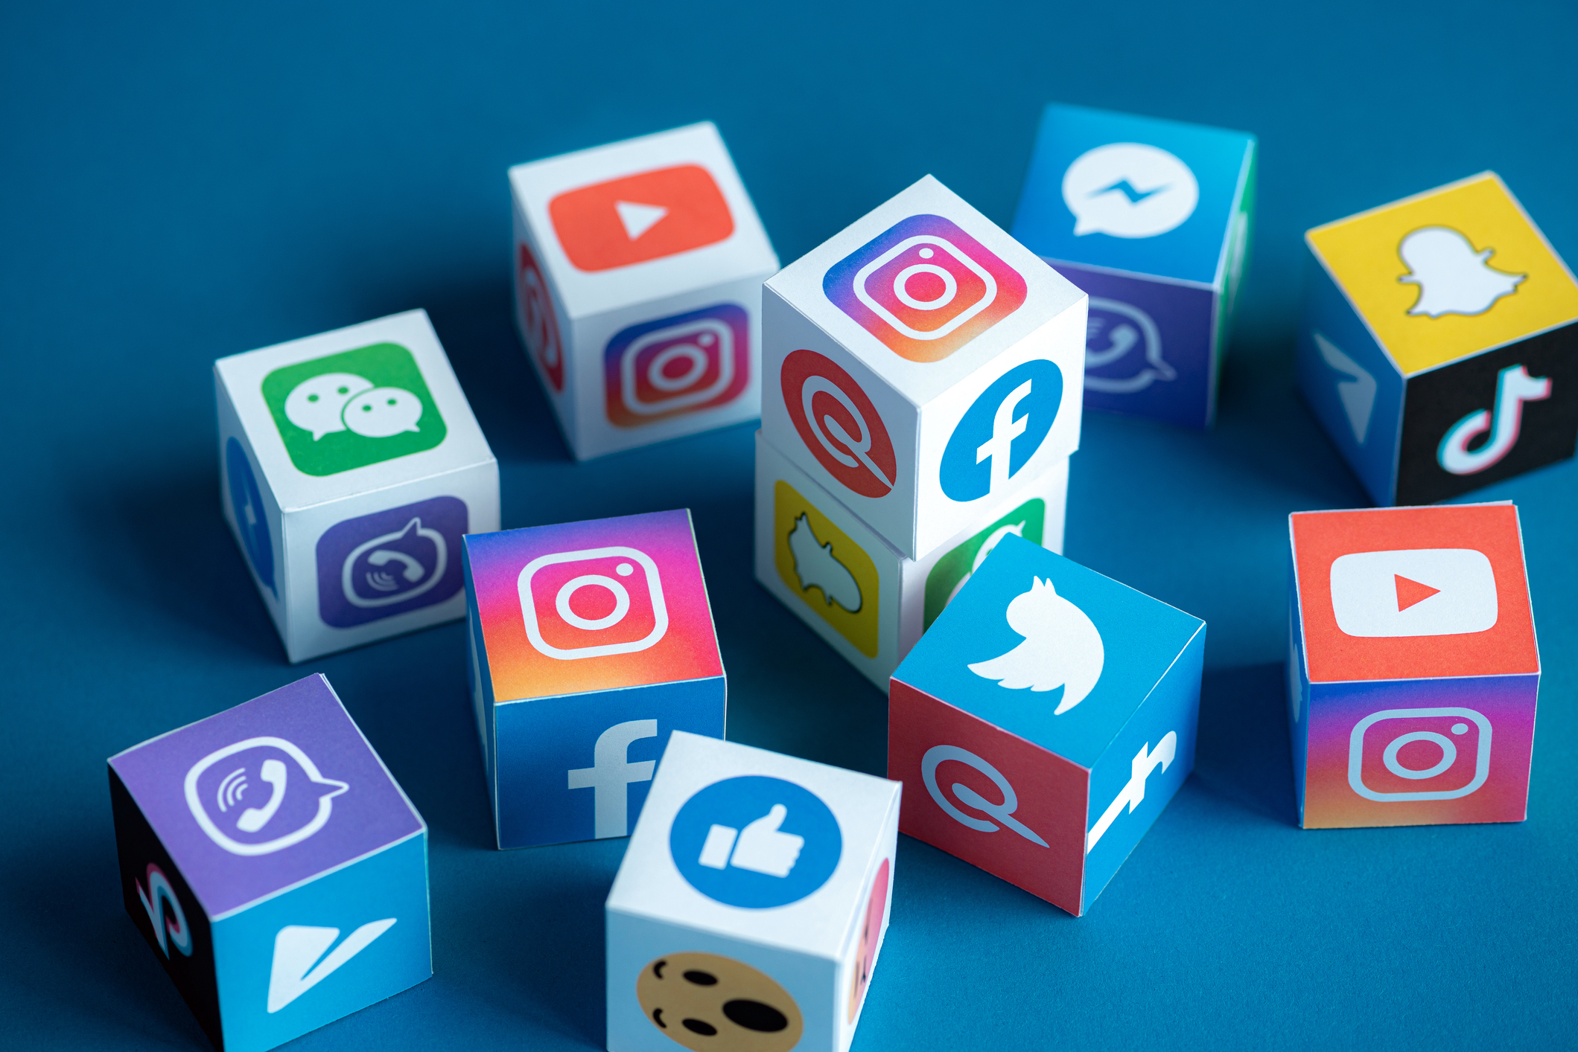
Here are some industries that uses text translation from images…
Legal and Law sector:
Translating text from legal documents, contracts, and court records to facilitate cross-border legal proceedings.
Social Media and Content Moderation:
Extracting text from images and videos to identify and moderate inappropriate or harmful content.

Slide 5
And my personal point of view, why I’ve choosed this topic mainly because, and my project aim is…
I believe that many students having problem while they’re interacting with documentations and extracting text from various sources (such as brochures, books, pamphlets etc.). So, with this program they will able to solve this very problem and overcome it.

Slide 6
Working principle of the program.
01
User chooses photo from file directory but it is recommended to use high resolution pictures (for better accuracy purposes.)

Slide 7
Working principle of the program(continued)
02
Afterwards, user implements Optical Character Recognition(OCR) via button to selected image. Then user has to press “Text” button in order to see texts before their translation. Finally user presses “Translation” button in order to see text’s translation.

Slide 8
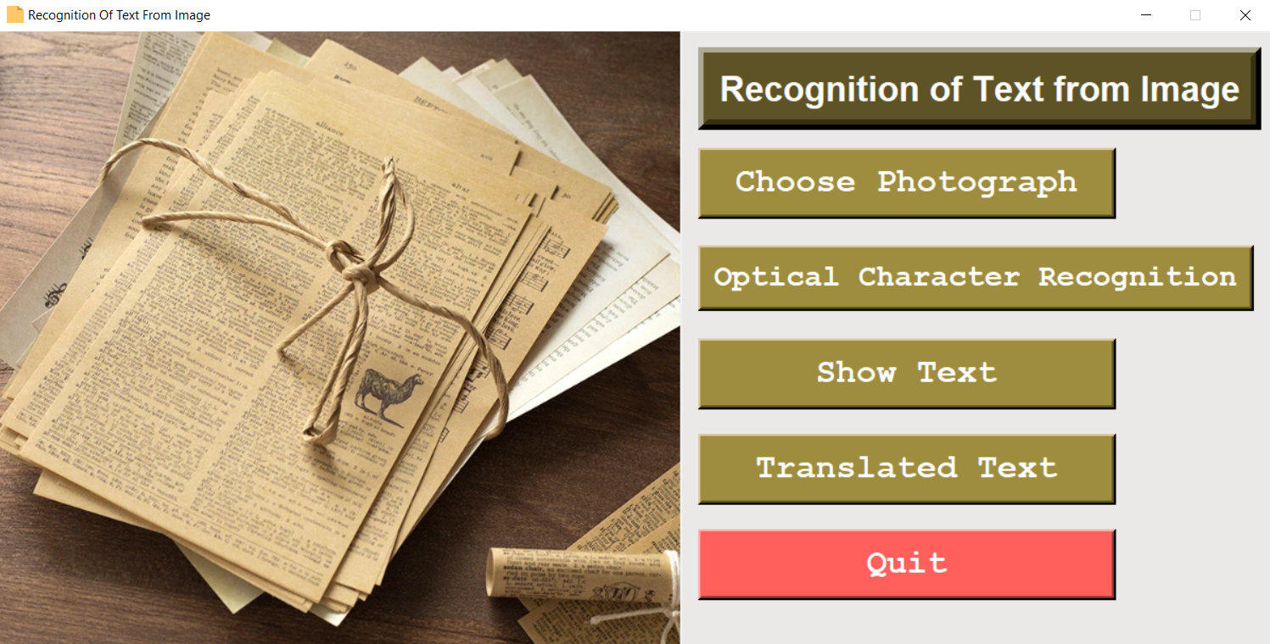
Here below, is my program GUI.

Slide 9
Challenges that I’ve encountered
Font and Style Dependency:
Tesseract-OCR's accuracy can vary depending on the font style, size, and type of text in the image. It may perform better with common fonts but struggle with unusual or decorative fonts.

Slide 10
Challenges that I’ve encountered (continued)
2. Performance on Complex Documents:
Tesseract-OCR may face challenges when dealing with complex documents containing multiple languages, mixed fonts, tables, or graphics. Extracting structured information from such documents may be harder.

Slide 11
Future development…
As I find more time in my daily life, I will try to improve this program’s capability for future needs and update the program in GitHub. I’m also planning to implement neural networks to enhance the capabilities of this program.

Slide 12

Thank you for your attention. Now let’s look up to the program.

